Slide 1


ETL Project
By Nicolas Bello & Sasha Osipova

Slide 2
Neonatal Deaths & Births Worldwide

Slide 3
**E**xtract
The data for the current project was collected from the following resources:
https://ourworldindata.org/grapher/annual-number-of-births-by-world-region
https://ourworldindata.org/suicide
The data was extracted as csv files

Slide 4
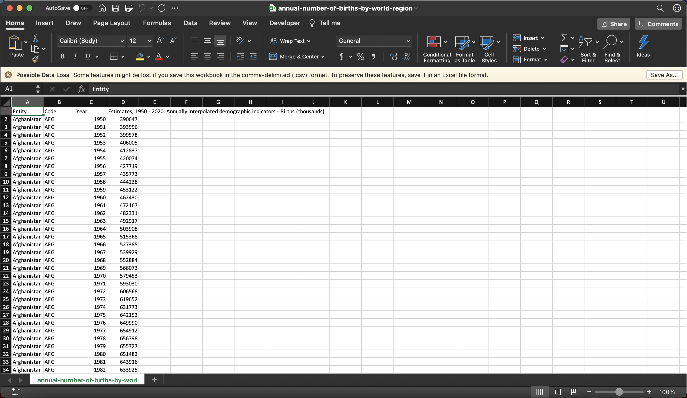
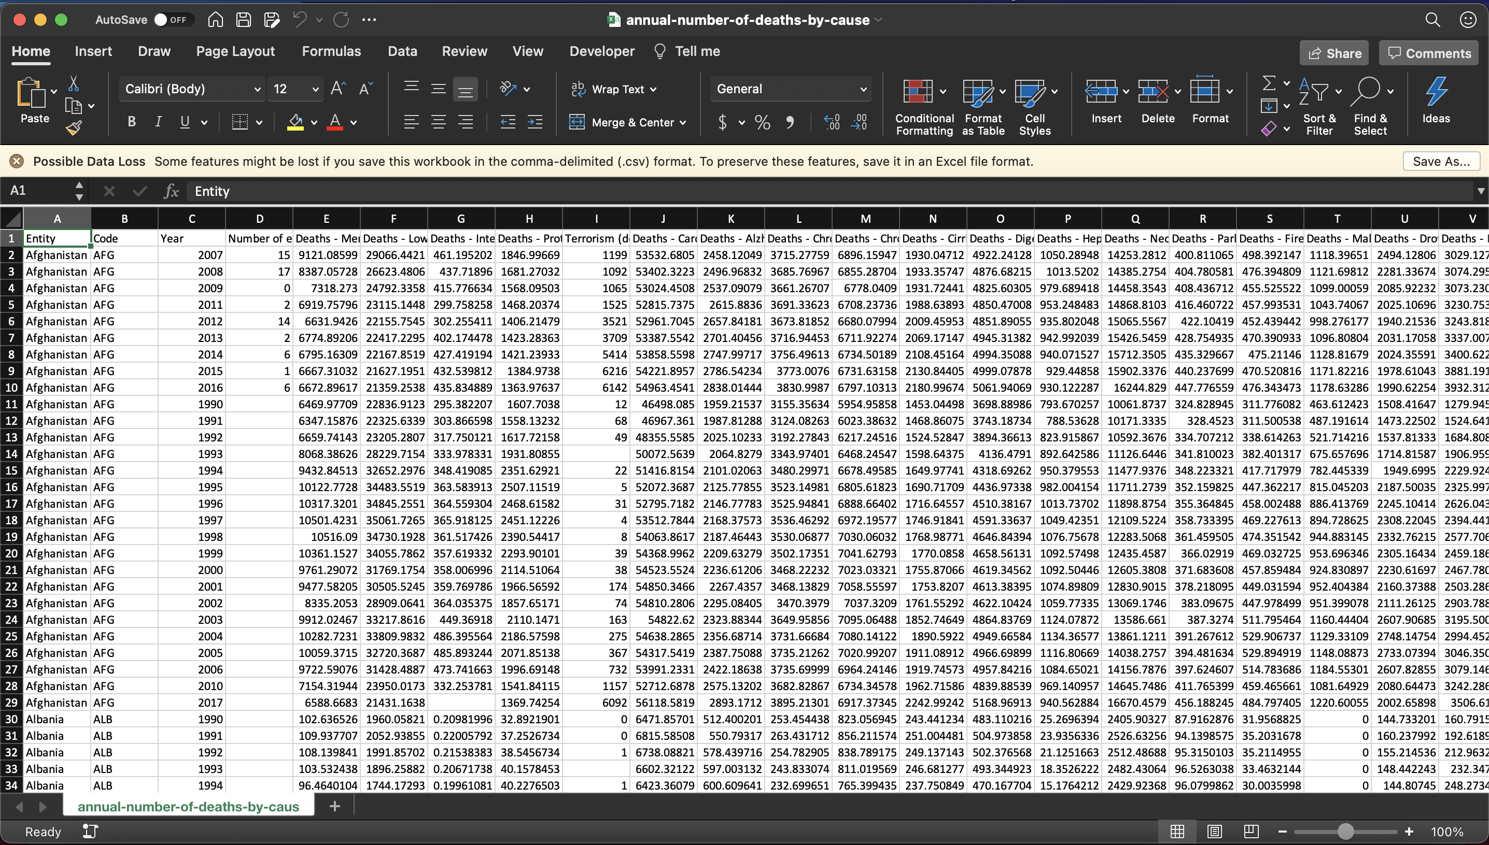

Slide 5
**T**ransform
The csv files were loaded into pandas
Cleaned by selecting only the columns needed
Renamed columns and dropped unwanted ones
Data filtered to include all countries and sorted by year in ascending order

Slide 6
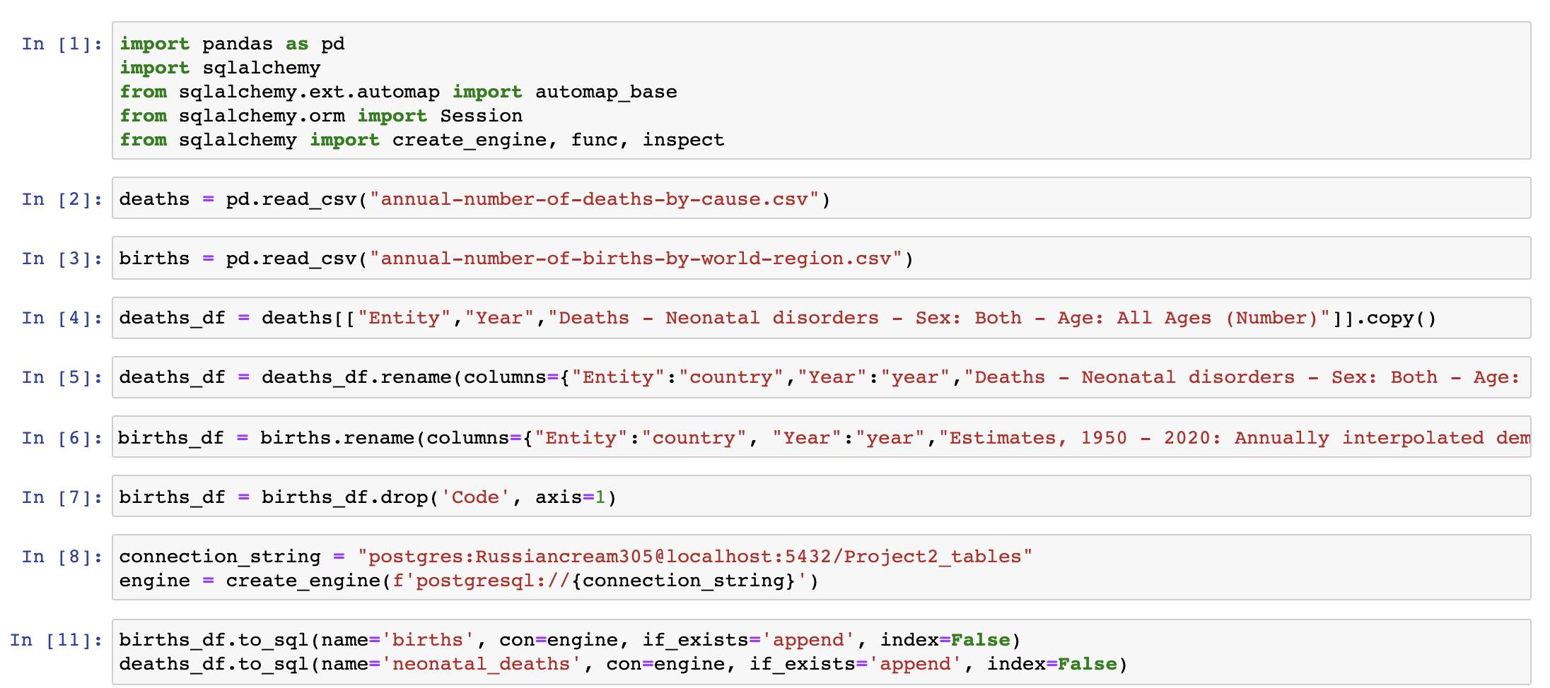

Slide 7
**L**oad
Prior to loading data, PostgreSQL tables were created with their corresponding labels
The final databases were loaded into pgAdmin4 and joined together on country and year.

Slide 8
